Slide 1
Chem 108: Lab
Week 5
Sign in: Roster @ front of lab
Remember the LETTER next to your name on the roster.
Pick up graded papers & handout

Slide 2
Due Today
Completed density calculations, graphs & Report Forms pp.20-25 (One form for each lab partner are to be turned in; stapled together. Neatest one on top.)
Check significant figures and calculations carefully. Uncertainty (+/-) values are not to be included, but measurement data must be correct relative to the experimental equipment used. Review returned Measurement Reports.
(GQ) On-line Density & Buoyancy Guiding Questions (individually done)

Slide 3
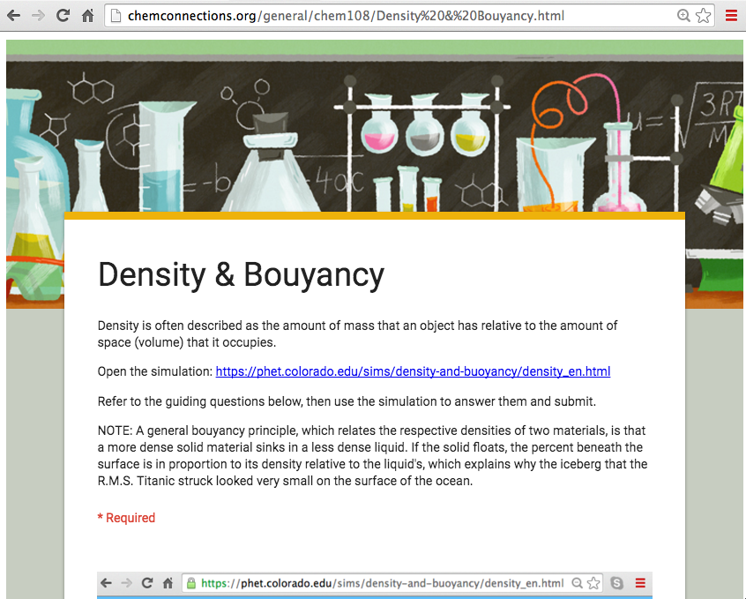
(GQ) On-line Density & Buoyancy Guiding
DUE Today
http://chemconnections.org/general/chem108/Density%20&%20Bouyancy.html

Slide 4
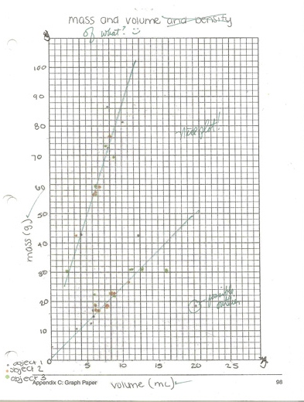

Plot of data (A) & (B) using blank graph paper
Either (A) & (B) on the same graph paper or separate pages.
Attach graph(s) to the combined Report Form pages
Complete the bottom table of handout and attach to the Report Forms to turn in.
Anyone plot the data using a spreadsheet?
http://chemconnections.org/general/chem108/Measuring%20Density-graphing.2017.pdf

Slide 5
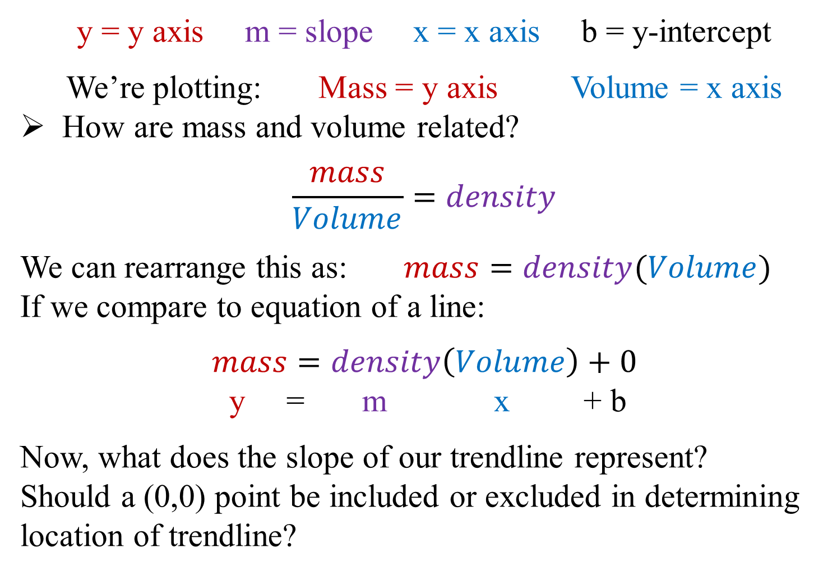
Equation of a line: Δy = mΔx + b
Δ
Δ
Δ
Δ
(Comparing the x,y values of any 2 points on the trendline.)

Slide 6
Using a Spreadsheet (Excel)
Density
 | Volume (cm3) | Mass (g)
 | 7.89 | 17.22
 | 6.80 | 18.11
 | 7.92 | 21.21
 | 9.75 | 22.25
 | 8.17 | 23.19
 | 9.84 | 25.44
 | 10.1 | 26.36
 | 11.4 | 28.29
 | 11.8 | 28.73
 | 11.7 | 29.69
AVG
Density

Slide 7
Using a Spreadsheet (Excel)
Density
 | Volume (cm3) | Mass (g)
 | 7.89 | 17.22
 | 6.80 | 18.11
 | 7.92 | 21.21
 | 9.75 | 22.25
 | 8.17 | 23.19
 | 9.84 | 25.44
 | 10.1 | 26.36
 | 11.4 | 28.29
 | 11.8 | 28.73
 | 11.7 | 29.69
AVG | 9.53 | 24.05
Density |  | 2.52
g/cm3

Slide 8
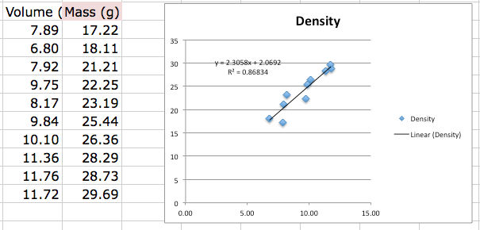
Using a Spreadsheet (Excel)
Youtube
https://www.youtube.com/watch?v=3kNEv3s8TuA
2.31 g/cm3
Volume (mL)
Mass (g)

Slide 9
Using a Spreadsheet (Excel)
Youtube
https://www.youtube.com/watch?v=3kNEv3s8TuA
 | A
Metal identified | Al = 2.64 g/cm3
Density (g/cm3) averaged | 2.52 g/cm³ +/-0.19
Error (%) averaged | (2.52-2.64)/2.64 * 100= 4.5%
Density (g/cm3) graphed | 2.31 g/cm³ +/-0.12
Error (%) graphed | (2.31-2.64)/2.64 * 100= 12.5%
Linear Regression straight lines improve precision.
They do not necessarily improve accuracy.

Slide 10

MOOCs: “Free” Courses
Learning to Use a Spreadsheet (Excel)
https://www.edx.org/course/analyzing-visualizing-data-excel-microsoft-dat206x-4
EdX
Coursera
Udacity

Slide 11
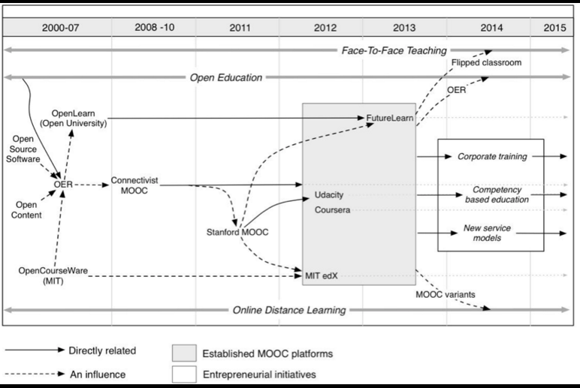
MOOCs: “Free” Courses
EdX
Coursera
Udacity

Slide 12
QUESTION
Rank the correct relative precision of the results from the two methods for Metal A’s density’s calculation. It’s accepted density is 2.64 g/cm³
.
Density |  | Density
Data Averaging |  | Linear Regression Straight Line
2.52 g/cm3 +/-0.19 |  | 2.31 g/cm3 +/-0.12
Precision: Straight Line > Averaging
B) Precision: Averaging > Straight Line

Slide 13
QUESTION
Rank the correct relative accuracy of the results from the two methods for Metal A’s density’s calculation. It’s accepted density is 2.64 g/cm³
.
Density |  | Density
Data Averaging |  | Linear Regression Straight Line
2.52 g/cm3 +/-0.19 |  | 2.31 g/cm3 +/-0.12
Accuracy: Straight Line > Averaging
B) Accuracy: Averaging > Straight Line

Slide 14
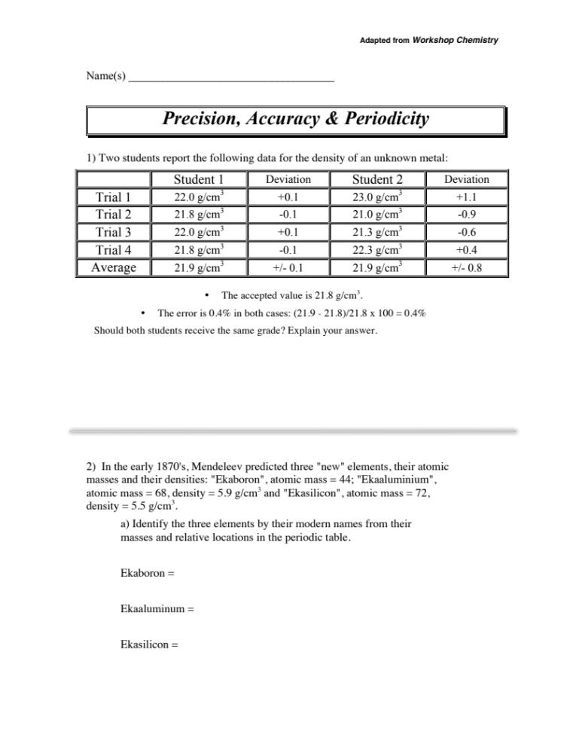
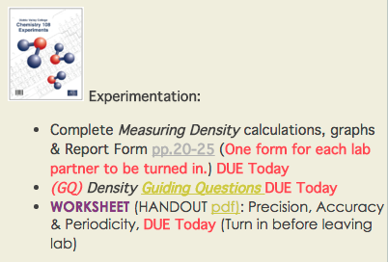
Worksheet:
Handout

Slide 16
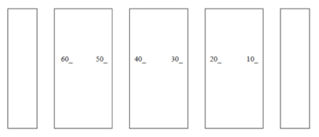
Experiment 3:
Classification of Matter and
Chemical Change
Move to the lab location that matches your roster letter with the map letter
Front of Lab
A
B
C
D
E
F
G

Slide 17
Experiment 3:
Classification of Matter and
Chemical Change refer to calendar link:
CHEM 108
http://www.chemconnections.org/general/chem108/Phys%20Properties-Separations%202017.htm
  Write yours and all partners’ names ON all REPORT FORMS, pp. 5-8, DUE Next Week

Slide 18
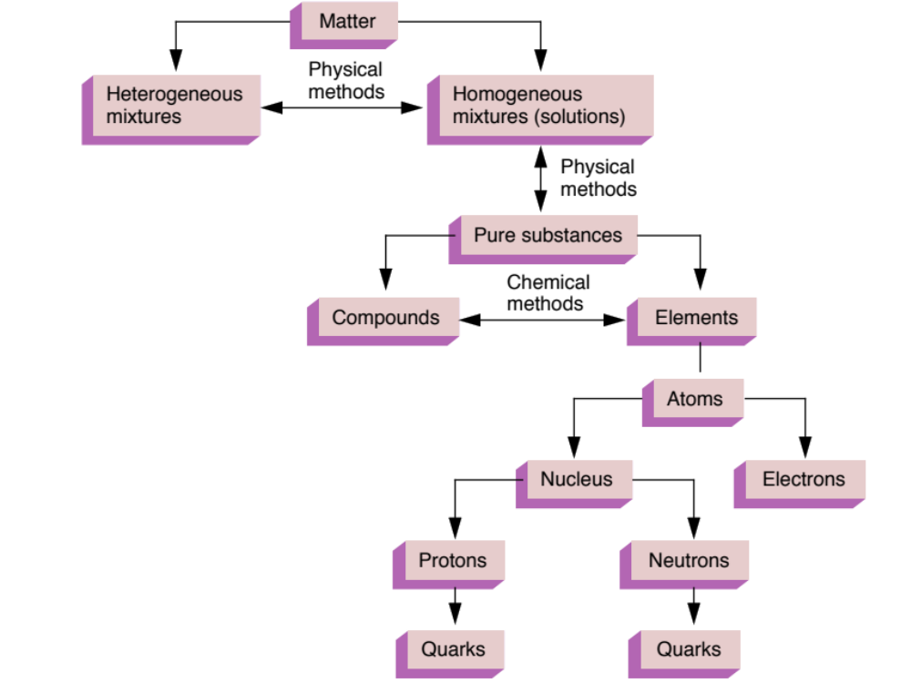
Organization of Matter
Classifying & Separating Matter
Mixtures → Pure Substances

Slide 19
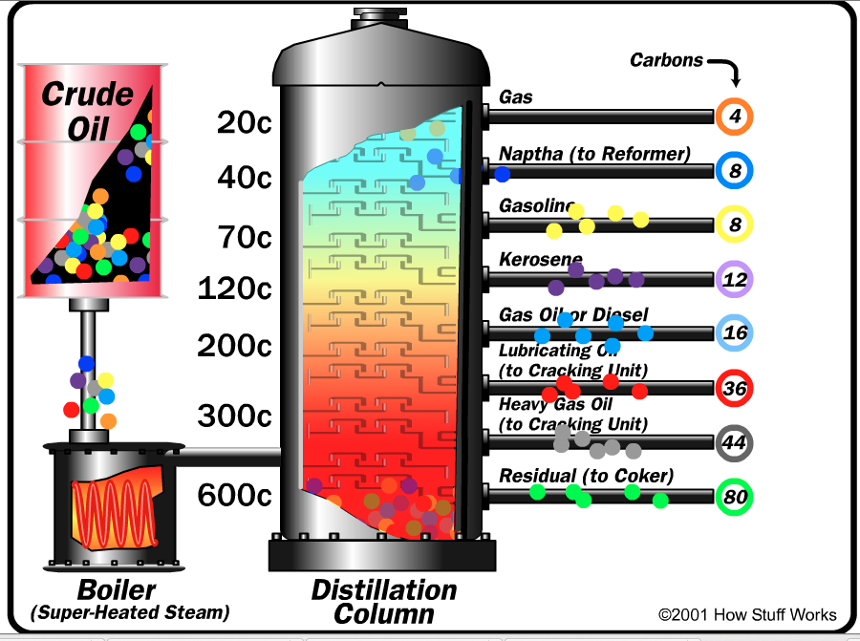
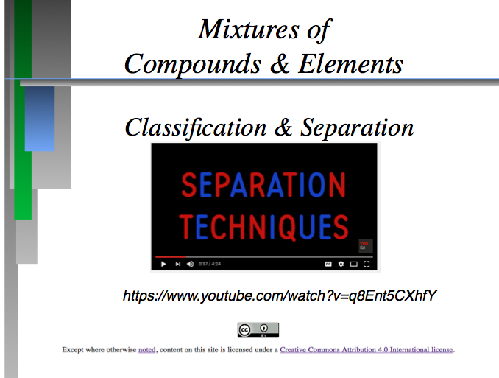
Classification of Matter and
Chemical Change
Refer to the calendar link:
http://www.chemconnections.org/general/chem108/Phys%20Properties-Separations%202017.htm
Filtration:
Crystallization:
Distillation:
Extraction:
Chromatography:

Slide 20
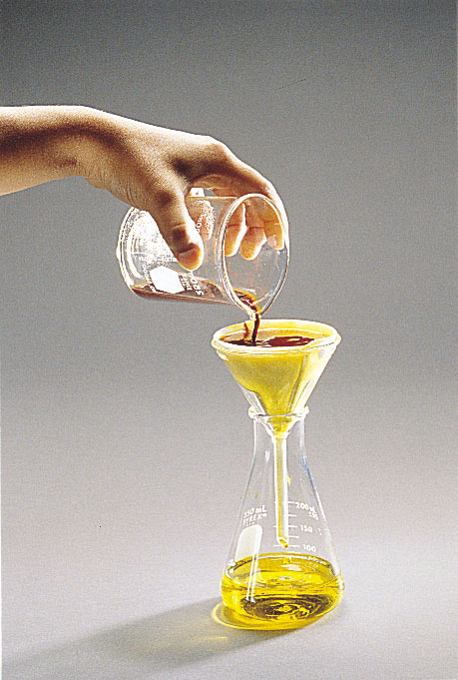
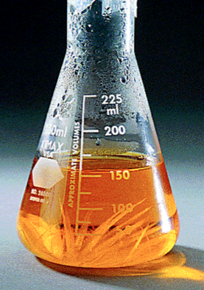
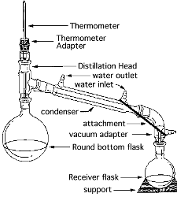
https://www.youtube.com/watch?v=q8Ent5CXhfY&t=17s
Separating Mixtures
: Separation of components in a mixture based upon differences in particle size. Examples: particles from air, coffee from grounds.
Separation based upon differences in solubility of components in a mixture. Example: rock candy
Separation based upon differences in boiling of components in a homogeneous mixture. Example: gasoline from crude oil
Filtration:
Crystallization:
Distillation:
http://chemconnections.org/general/movies/html-swf/oil-refining.swf

Slide 21
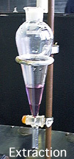

https://www.youtube.com/watch?v=q8Ent5CXhfY&t=17s
Separating Mixtures
Separation based upon differences in a compound’s solubility between two different solvents, typically immiscible liquids. Examples: gasoline (hydrocarbons) and water.
Separation based upon differences a compound’s solubility in a solvent versus a stationary phase. Examples: paper chromatography, thin layer (TLC), column, gas-liquid (GC); liquid-liquid: (HPLC), reverse phase.
Extraction:
(Chemical Separation) Chromatography:

Slide 22
Classification of Matter and Chemical Change
Goals:
  Part A: To classify a pure substance as a homogeneous or heterogeneous mixture and quantify the mixture’s components
  Part B: To classify a material as a pure substance or mixture based on observation
  Part C: Using Paper Chromatography to classify inks as pure substances or homogeneous mixtures
  Part D: Determining if chemical changes occur.
Work with your partners
  Be sure to write partner’s name ON ALL REPORT FORMS

Slide 23
Classification of Matter and Chemical Change
Working with your partners
  Bring completed report forms with your name and partners’ name ON ALL REPORT FORMS to Dr. R.
  Dr. R will provide each group with 2 unkown mixtures of sand and salt to be quantitatively analyzed.
  Decide who will do which unknown. Record unknown numbers on the respective individual Report Form(s) .

Slide 24
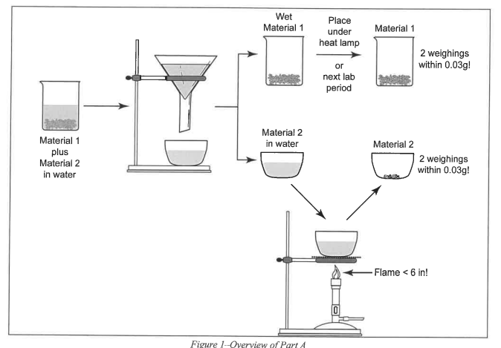
Classification of Matter
Part A: Procedural Scheme

Slide 25
Classification of Matter and Chemical Change
Measuring solids (Part A):
Weigh empty container (beaker) & record mass
Remove beaker from balance and pour solid into the beaker
Place the beaker with the solid back on the balance & record mass
DO NOT pour any materials/ chemical into containers while on balance pan; clean area and balance of any loose /spilled materials/ chemicals before leaving, close all bottles

Slide 26
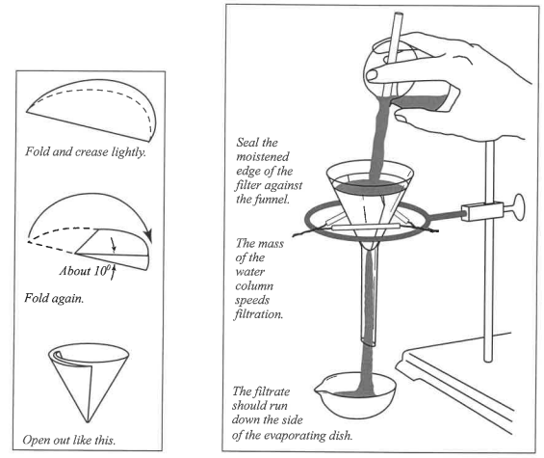
Classification of Matter
Filtration

Slide 27
Part A
Use a minimal amount of H₂O when transferring solids from beaker into filter; too much causes evaporation time to be VERY long
PROCEDURE to note & follow:
Boil filtrate gently until no drops are observed on watch glass
  If boiled too rapidly, crystals collect on watch glass
  SAFETY TIP: Hot evaporating dish will shatter if placed on cold lab bench – Allow to cool on grating before placing on bench
DO NOT dry Material 1 and filter paper under heat lamp. Store in your lab drawer covered by paper towel . . . by the next lab session, they will be very dry
WASTE: (to be handled next lab session)
  Filter paper and Material 1 in trash
  Material 2 in sink with H₂O running

Slide 28
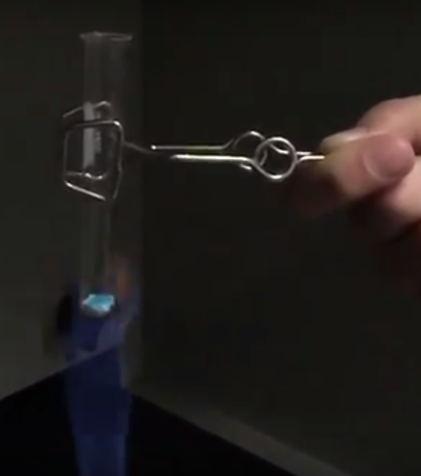
Part B: CuSO₄• 5H₂O
Copper(II) sulfate pentahydrate
  May be labeled cupric sulfate pentahydrate
Heat the hydrate gently in a test tube
Waste:
  Add in minimum amount of H₂O and stir to dissolve all solid
Pour solution into red “Aqueous Metal Waste” container in hood
Be sure to record “color” and/or “clarity” BEFORE discarding any solutions or chemicals
e.g.) solution: blue and cloudy, solution: colorless and clear, soliid: white

Slide 29
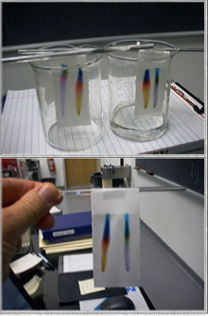
Classification of Matter
Part C – Paper Chromatography)

Slide 30
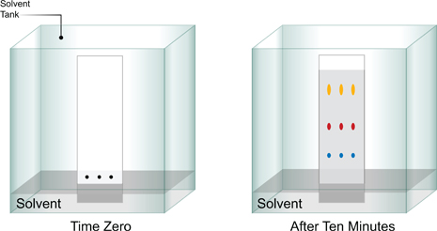
Part C – Paper Chromatography
Use water-soluble pens that are provided, DO NOT use your own pen
  DO NOT use permanent pens/markers
Beaker with pure water as solvent
Show Dr. R. paper chromatogram before leaving lab today.
Waste: water in sink

Slide 31
  PROCEDURE: Before starting Part D, dispense 3-4mL of 6M NaOH and 3-4mL of 6M HCl into separate test tubes: 6M means 6 Molar = 6 mol/L; Molarity is an important unit of concentration
  Take to YOUR LAB BENCH for Parts D.1 and D.3
Avoid spilling NaOH or HCl
  If spilled, neutralize with solid NaHCO₃ (sodium bicarbonate) from bucket, then wipe with paper towel
    An acid + base react to produce a salt and water
Waste for D.1:
  Pour all solutions into NaHCO₃ in hood sink with H₂O running

Slide 32
Part D.2:
Waste for D.2:
  Into red “Aqueous Metal Waste” container in hood
Part D.3:
20 drops HCl ≈ 1mL, add “dropwise”
Waste for D.3:
  Into NaHCO₃ in hood sink with H₂O running
Part D.4:
Waste for D.4:
  Into red “Aqueous Metal Waste” container in hood

Slide 33
Exp. 3 – Classification of Matter and Chemical Change
DUE Next Lab Period
Report Forms: One form for each lab partner are to be turned in; stapled together. Neatest one on top.
  Staple Paper Chromatogram to Report Form.
  Check sig figs are correct and units included
  Show example of each type of calculation
  Answer questions legibly in complete sentences.

Slide 34
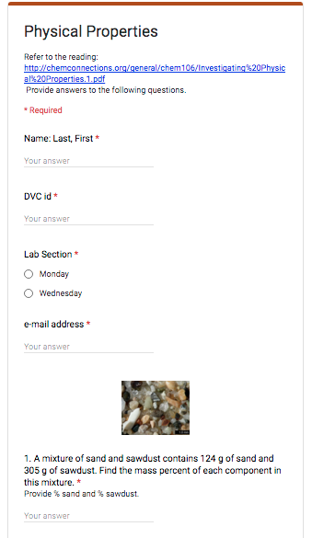
  Individually complete on-line post-lab questions and submit on-line:
  http://www.chemconnections.org/general/chem108/Physical%20Properties.html
DUE Next Lab Period

Slide 35
Due Today
Worksheet:
Handout
Complete Worksheet in collaboration with your assigned group partners.
Turn in before leaving lab today.

